Slide 1
Agenda
Decomposition & Integration Patterns
Decomposition Patterns
  Decompose by Business Capability
  Decompose by Subdomain
  Decompose by Strangler
Integration Patterns
  API Gateway Pattern
  Aggregator Pattern
  Client-Side UI Composition Pattern
  Backend for Frontend (BFF) Pattern

Slide 2
Decomposition Patterns
Problem: Microservices make loosely coupled services that apply the single responsibility principle. However, breaking an application into smaller pieces has to be done logically. How do we decompose an application into small services?
Solution: There are the following patterns to rescue the above problem:
  Decompose by Business Capability
  Decompose by Subdomain
  Decompose by Strangler - Legacy App

Slide 3
1. Decompose by Business Capability
Microservices should be decomposed by business capability. A business capability often corresponds to a business object, ensuring that each microservice handles a specific aspect of the business.
Business capabilities of an online store include:
  Authentication Management
  Catalog Management
  Order Management etc.

Slide 4
2. Decompose by Subdomain
Domain-Driven Design (DDD) refers to the application’s problem space, the business as the domain.
A domain consists of multiple subdomains and each subdomain corresponds to a different part of the business.
The subdomains can be classified using the following criteria:
  Core: Most important and key differentiator of an application.
  Support: Business-related and are used to support business activities.
  Generic: Not specific to business but is used to enhance business operations.
Notes:
When building applications, DDD talks about problems as domains and subdomains.
Identifying subdomains is not an easy task. It requires an understanding of the business. Like business capabilities, subdomains are identified by analyzing the business and its organizational structure and identifying the different areas of expertise.

Slide 5
2. Decompose by Subdomain Contd..
For example, the subdomains of an E-Commerce Domain application include:
  Catalog Management (Catalog Service)
  Inventory Management (Inventory Service)
  Order Management (Order Service)
  Delivery Management (Delivery Service)

Slide 6
2.1 Decompose Traditional Data Model
Decompose traditional model into multiple domain models i.e. One domain model per microservice or bounded context.
Order Service
User
-Id
-Name
-Address
-Status
…..
Buyer
-Id
-Name
-Address
Product
-Id
-Description
Product
-Id
-Description
-Price
…..
Payment Service
User
-Id
-Status
Product
-Id
-Price

Slide 7
Decomposing by business capability VS. by subdomain
Decompose by Business Capability
Divides the application into steps reflecting how the business operates.
For instance, a customer interacts with the product catalog service to see available products, places an order through the order service, which then triggers the inventory service to update stock, followed by the delivery service to finalize customer details and ship the order.
Decompose by Subdomain
Focuses on the information flows within the business process.
For example, to implement promotions, instead of altering the order management service (as in business capability decomposition), a new subdomain for promotions might be created. This new promotion service would then interact with the order management service to apply relevant promotions.

Slide 8
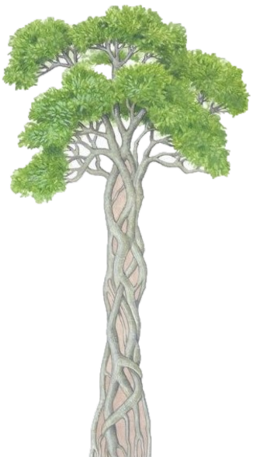
3. Strangler Pattern
This pattern is used to decompose an existing, monolithic application. Since applying all the above design patterns to them will be difficult because breaking them into smaller pieces at the same time it's being used live is a big task.
The Strangler pattern creates two separate applications that live side by side in the same URI space. Over time, the newly refactored application “strangles” or replaces the existing monolithic application.
Banyan Tree

Slide 9
3.1 Strangler Pattern
Strangler Application
Service
Service
Service
Service
Service
Service
Service
Service
Service
Service
Service
Service
Service
Service
Service
……
Service
Service
Time
Monolith
App
Monolith
App
Monolith
App
……
Monolith
App
Existing Features
New Features

Slide 10
Integration Patterns
Problem: When an application is broken down into smaller microservices, there are a few concerns that need to be addressed:
  There are multiple calls for multiple microservices by different channels
  There is a need for handling different types of Protocols
  Different consumers might need a different format of the responses
Solution: Following patterns to rescue the above concerns:
  API Gateway Pattern
  Aggregator Pattern
  Client-Side UI Composition Pattern
  Backend for Frontend (BFF) Pattern

Slide 11

1. API Gateway Pattern
An API Gateway is a single point of entry for any microservice calls.
Work as a proxy service to route a request to the backend microservices.
Aggregate the results to send back to the consumer.
Offload the authentication/authorization responsibility of the microservice.
Catalog Microservice
API Gateway
Routing
Authentication Microservice
(Authentication,
response caching)
Order Microservice

Slide 12

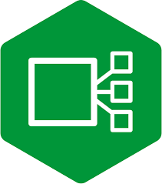


Microservices API Gateways
Ocelot API Gateway
NGINX Ingress Controller
Azure API Management
AWS API Management
Free: Open Source
Cloud Managed
Notes:
Compare NGINX Ingress Controller Models - NGINX

Slide 13
2. Aggregator Pattern
Aggregator patterns help your how to collaborate the data returned by each service.
Aggregation can be done in two ways:
  A composite microservice will make calls to all the required microservices, consolidate the data, and transform the data before sending it back.
  An API Gateway can also partition the request to multiple microservices and aggregate the data before sending it to the consumer.
Notes:
When building applications, DDD talks about problems as domains and subdomains.
Identifying subdomains is not an easy task. It requires an understanding of the business. Like business capabilities, subdomains are identified by analyzing the business and its organizational structure and identifying the different areas of expertise.

Slide 14
3. Client-Side UI Composition Pattern
With microservices, the UI has to be designed as a skeleton with multiple sections/regions of the screen/page.
Each section will make a call to an individual backend microservice to pull the data. That is called composing UI components specific to the service.
Frameworks like Angular and React help to do that easily. These screens are known as Single Page Applications (SPA).
This enables the app to refresh a particular region of the screen instead of the whole page.
Notes:
When services are developed by decomposing business capabilities/subdomains, the services responsible for user experience have to pull data from several microservices.

Slide 15
4. Backend for Frontend (BFF)
Creates a specialized backend service for each type of client (e.g., mobile, web, desktop).
Instead of having a single API Gateway, each client gets its own dedicated backend, which provides an optimized API tailored to the client’s specific needs.
Minimizes over-fetching or under-fetching of data by customizing the backend logic for each client type.
Useful when you need to optimize the API for specific devices, such as mobile apps with limited bandwidth or web apps with more complex UI but have different data requirements, response formats, or processing logic.

Slide 16
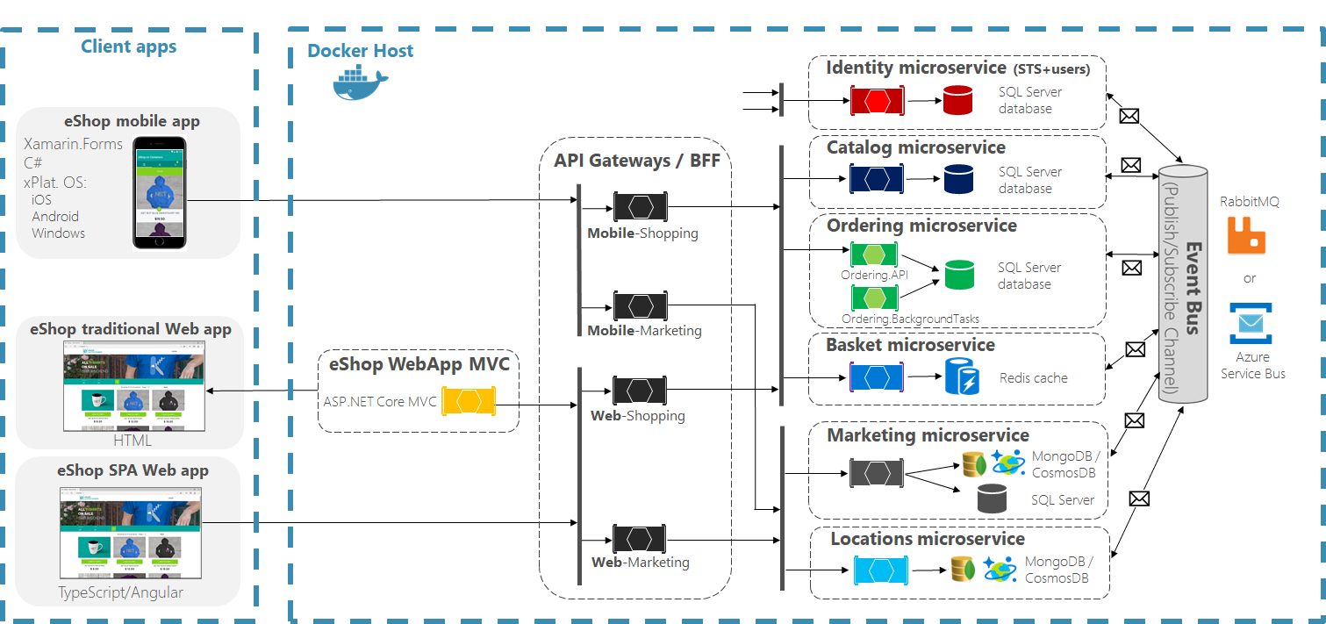
Backend for Frontend (BFF)

Slide 17
API Gateway vs. Backend for Frontend (BFF)
Aspect | API Gateway | Backend for Frontend (BFF)
Purpose | Single entry point for all clients and services. | Separate backends tailored to each client (e.g., mobile, web).
Client Optimization | One-size-fits-all for all clients. | Optimized for each client type (e.g., mobile, web, desktop).
Cross-Cutting Concerns | Centralized (security, logging, rate-limiting, etc.). | Handled individually in each BFF.
Complexity | Simpler for the client, but may become a monolith. | More complex due to multiple BFFs, but more modular.
Performance | Can introduce latency due to additional processing. | More efficient for clients (tailored APIs reduce overhead).
Maintainability | Easier to manage as there is a single entry point. | More components to manage and maintain (one BFF per client).
Use Case | Best for systems where clients have similar needs. | Best for systems with diverse client needs and data handling.

